Slide 1

Comprehensive Banking Analytics
Presented by
Nandhagopal S

Slide 2
Problem Definition:
To enhance the Decision Making in loan approval process, this project is aims to address the customer segmentation and Credit Risk Assessment.
Solution:
Customer Segmentation
Grouping Customers based on banking behaviours, Transaction histories, and demographics to understand their financial profiles better
Credit Risk Assessment
Developing a robust credit scoring system that evaluates loan approval based on the historical data, clustering analysis, and predictive modelling for creditworthiness and late payment risks.

Slide 3
Benefits
Enhanced Customer Segmentation
Cost Reduction
Automation and accurate risk assessment reduce the need for extensive manual reviews, lowering operational cost and improving efficiency.
Better segmentation allows for more personalized and targeted financial products and services
Improved Accuracy
Machine learning models provide more accuracy predictions for loan approval by analyzing vast amount of data, reducing human errors.
Risk Assessment
Data-Driven insights
Effective credit risk assessment helps in identifying high risk customers, thereby reducing the like hood of loan defaults and financial losses.
ML models provide valuable insights into customer behavior and financial health, enabling banks to make informed decisions and strategies

Slide 4
Data Collection: Feature details of Given dataset (train.csv)
01. ID
02. Customer ID
03. Month
04. Name
05.Age
ID number for customer’s
Customer ID for each customer’s
Indicating the month of transaction
Name of the Customer’s
Age of the Customer’s
06. SSN
07. Occupation
08. Annual Income
09. Monthly in hand salary
10. No. of Bank Accounts
SSN number of customer’s
Customer’s occupation detail
Customer’s Annual Salary income information
Customer’s Monthly in hand salary information
Total no. of banks owned by customer
11.Num_Credit_Card
12. Interest_Rate
13. Num_of_Loan
14. Type of loan
15. Delay_from_due_date
Total no. of credit card owned by customer
Interest rate of loan
Total no. of loan with customer
Type of loan customer purchased
No. of delay payment from due date
16. Num_of_Delayed_Payment
17. Changed_Credit_Limit
18. Num_Credit_Inquiries
19. Credit_mix
20. Outstanding_Debt
No. of delay payment done by customer
The difference between the previous and new credit limits.
Credit inquiries from customer
Credit score based on the variety of credit accounts that a customer has.
Outstanding_Debt of a credit accounts
21. Credit_Utilization_Ratio
22. Credit_History_Age
23. Payment_of_Min_Amount
24. Total_EMI_per_month
25. Amount_invested_monthly
Credit_Utilization_Ratio of credit accounts
Credit history age of customer
Labeled feature if customer likely have min amount for credit account
Total amount of EMI need to pay for the customer
Invested amount by customer
26. Payment_Behaviour
27. Monthly_Balance
28. Credit_Score
Labeled feature of customer payment behavior's
Monthly balance amount after all the debit by customer
Labeled feature of Credit Behavior

Slide 5
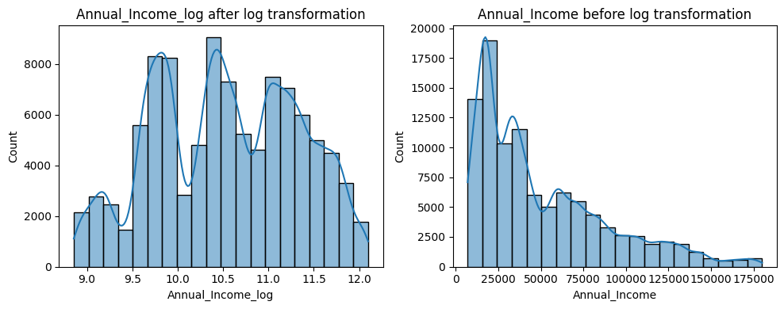
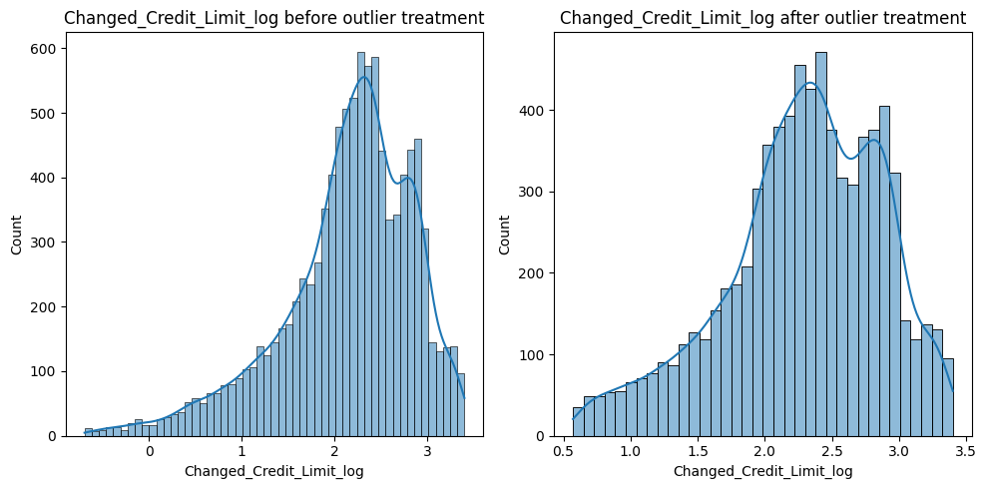
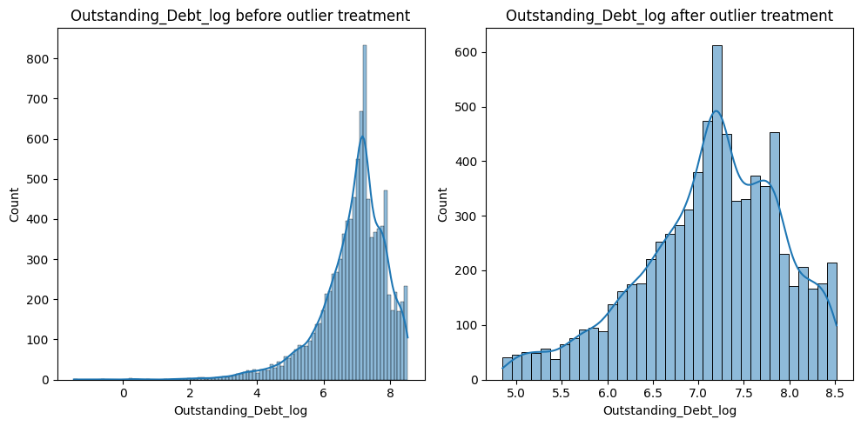
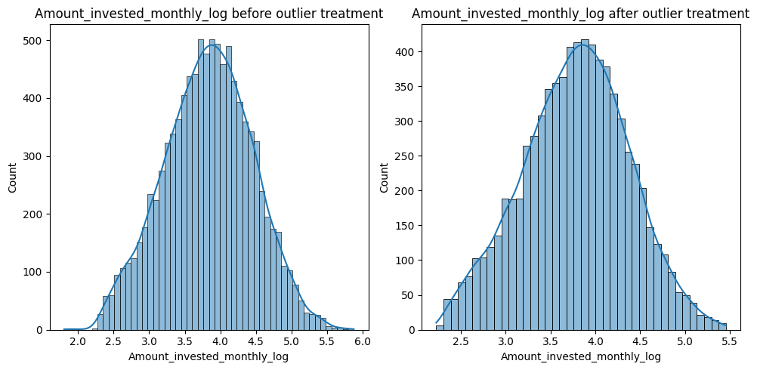
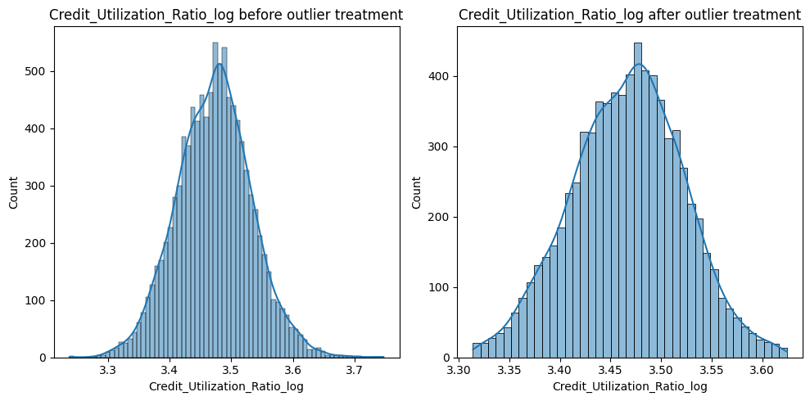
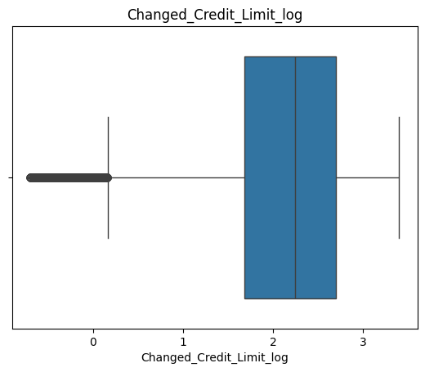
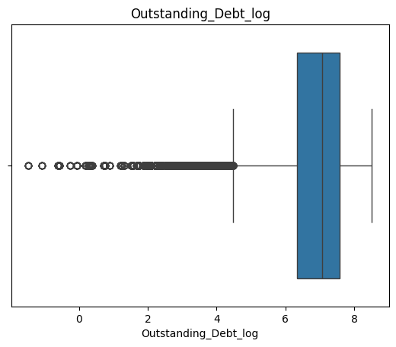
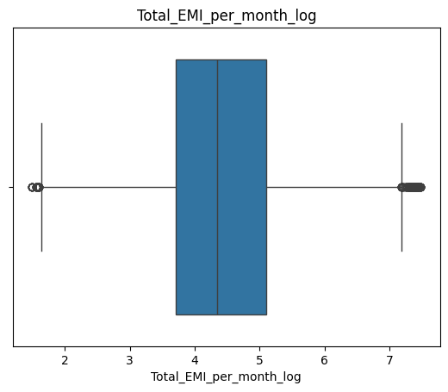
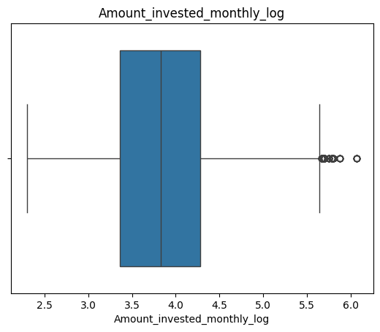
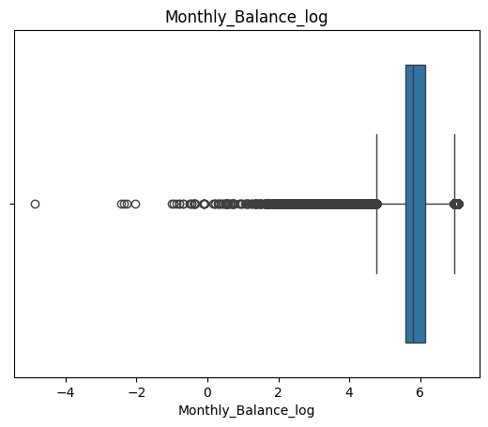
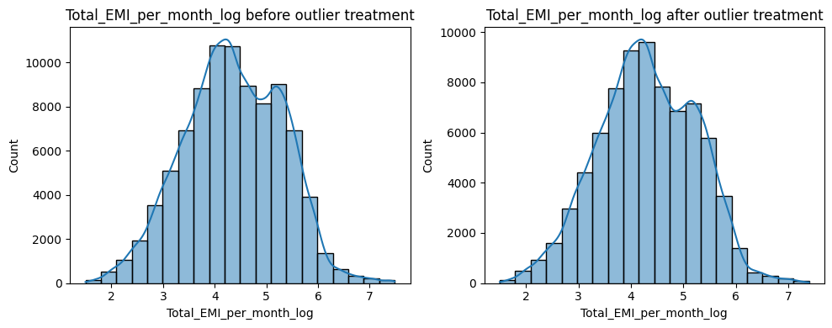
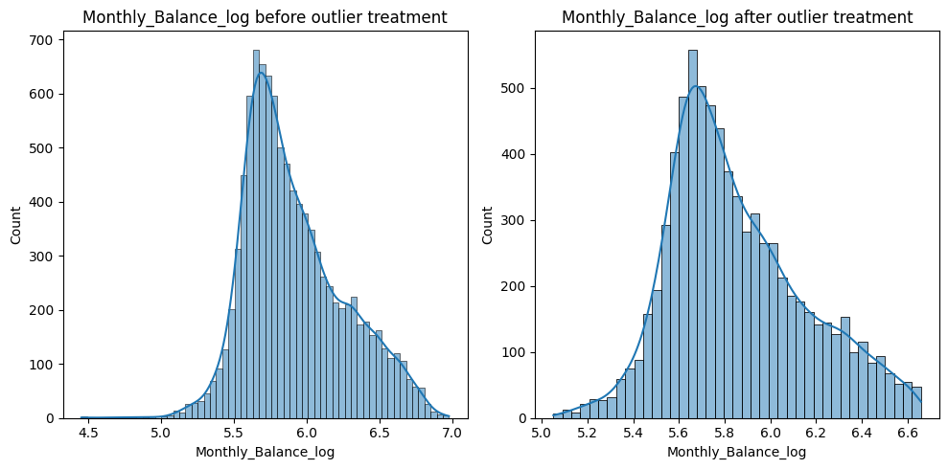
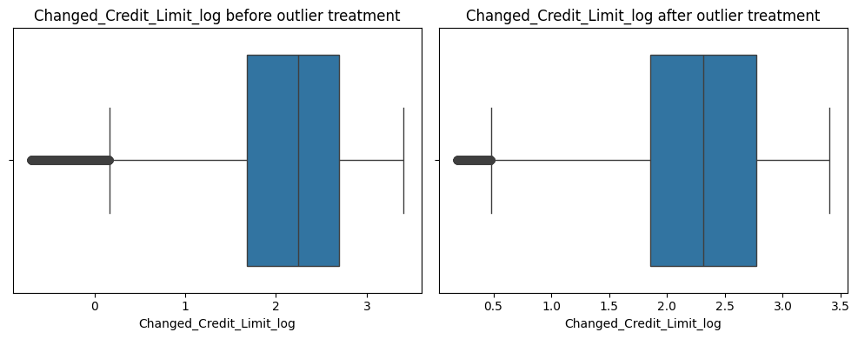
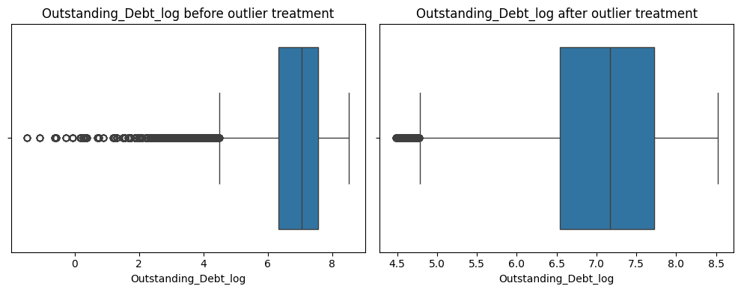
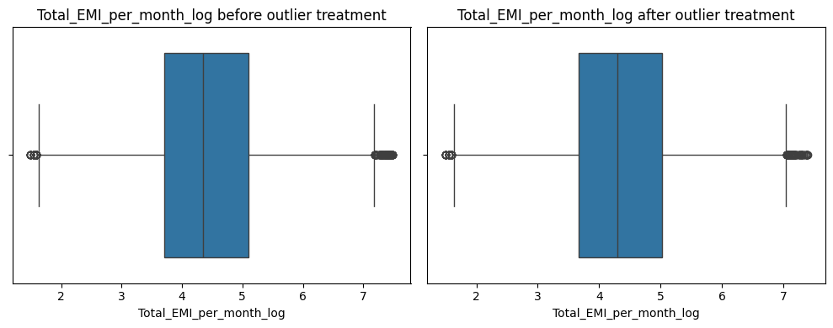
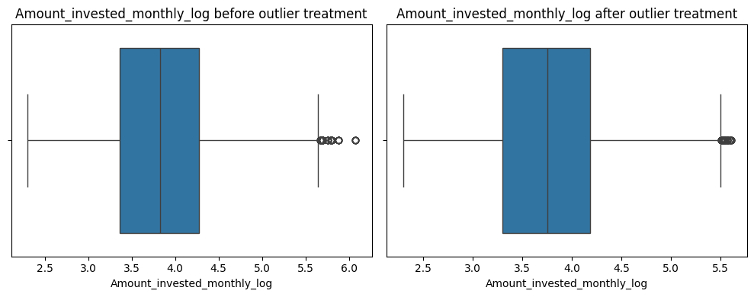
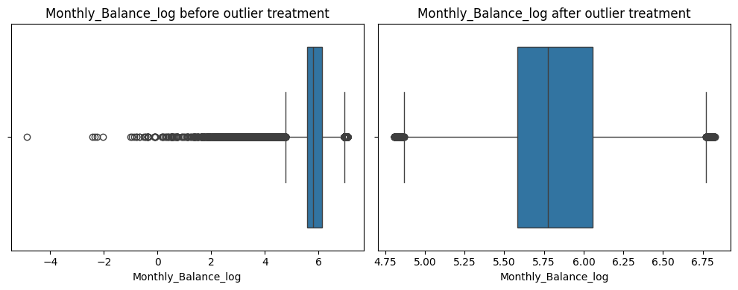
EDA : Exploratory Data Analysis
Skewed Data after log transformation Comparison
Comparison of Distribution after outlier treatment Using IQR Method
Summary
Method Used:
Interquartile Range (IQR) Method
IQR = Q3 – Q1
Lower Bound:
Q1 - 1.5 * IQR
Upper Bound:
Q3 + 1.5 * IQR
Action Taken:
Outliers beyond the lower and upper bounds were identified and removed.
Outcome:
After handling outliers, the data is cleaned and ready for the next step in the machine learning process.
Our Data is Positively skewed (right Skewed) and handled by log transformation to compress the data and brings distribution closer to normal. This makes ml algorithm that assume a normal distribution.
Outliers and treatment (Using IQR Method)

Slide 6
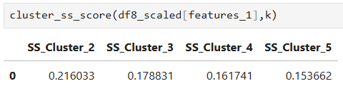
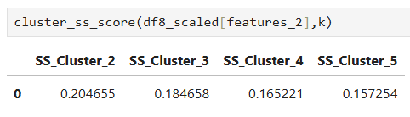
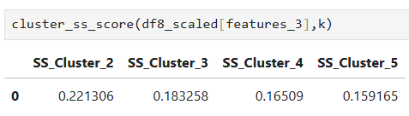
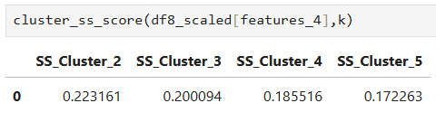
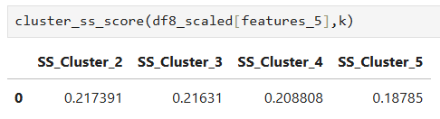
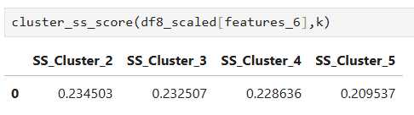
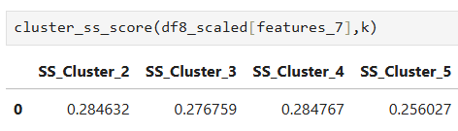
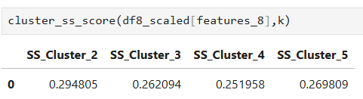
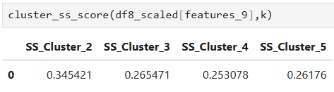
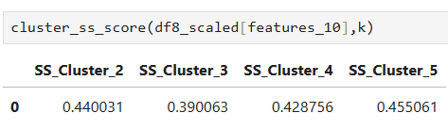
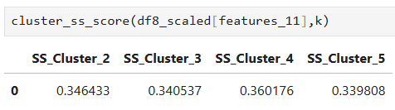
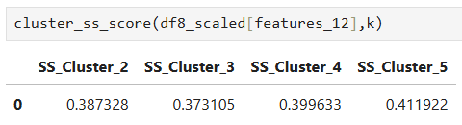
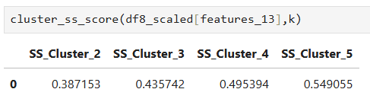
Model Training – Clustering(Unsupervised learning)
Feature-1
Feature-2
Feature-3
Feature-4
Feature-5
Feature-6
Feature-7
Feature-8
Feature-9
Feature-10
Feature-11
Feature-12
Feature-13
Insights
Among the 13 feature sets feature_13 is performing well with 5 clusters
Based on the silhouette score feature_13 with n_clusters = 5 having the silhouette score of 0.549055 within the range of 0.50 to 0.75 which means Good Clustering

Slide 7
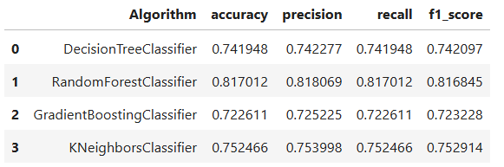
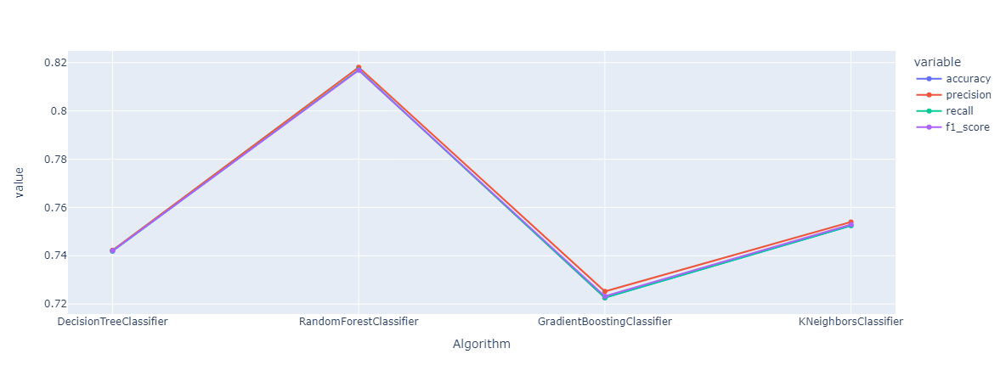
Model Selection & Training (Classification):
Our Model is Multi class classification(Supervised learning) to find the credit score of customer based on banking transaction behavior. Algorithms for our problem is
Decision Tree Classifier
Random Forest Classifier
KNN Classifier
Gradient Booster Classifier (GBM)
Algorithm Metrics for our trained model
Visualization of Algorithm performance metrics
Insights
Best Overall Model: The Random Forest Classifier stands out as the best performing model with the highest accuracy (0.8170), precision (0.8181), recall (0.8170), and F1 score (0.8168), indicating that it is the best performing model for this dataset. The consistency across these metrics suggests it is a reliable and balanced model.
Moderate Performers: The Decision Tree and K-Nearest Neighbors classifiers exhibit moderate performance.
Lower Performance: The Gradient Boosting Classifier has the lowest performance metrics in this comparison.
Hyperparameter Tunning: Grid Search CV ( To avoid under fitting and over fitting the model we will find the best parameters for our model)
7

Slide 8
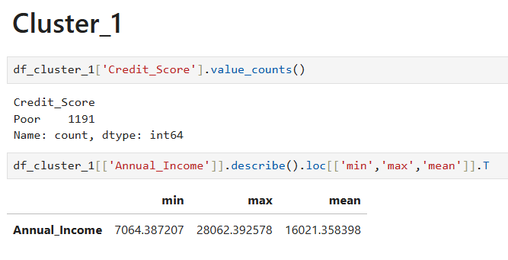
Customer Segmentation-Cluster-1-Insights
Descriptive and Perspective Analysis
Cluster-1
Low Income: Poor Credit Score: Customers in Cluster 1 have a low mean annual income of approximately 16,021.36, with a minimum of 7,064.39 and a maximum of 28,062.39. This indicates that they are in a lower income bracket. Additionally, all customers in this cluster have been categorized as having a poor credit score.
Financial Vulnerability: The combination of low income and poor credit score suggests that customers in Cluster 1 may be financially vulnerable. They may have limited access to credit or financial resources, making them more sensitive to economic fluctuations or unexpected expenses.
Risk Assessment: From a risk assessment perspective, customers in Cluster 1 may present a higher risk for default or late payments. We need to carefully evaluate their creditworthiness and may consider offering lower credit limits or higher interest rates to mitigate potential risks.
Targeted Financial Products: Given their financial situation, customers in Cluster 1 may benefit from tailored financial products and services that cater to individuals with low income or poor credit history. This could include microloans, financial literacy programs, or credit-building products.
Support and Assistance: Providing financial education and support to customers in Cluster 1 could help improve their financial well-being. This could include budgeting tips, debt management strategies, or access to financial counseling services.
Overall, Cluster 1 represents a segment of customers who are financially vulnerable and may require specialized financial products and support to improve their financial stability and creditworthiness.
8

Slide 9
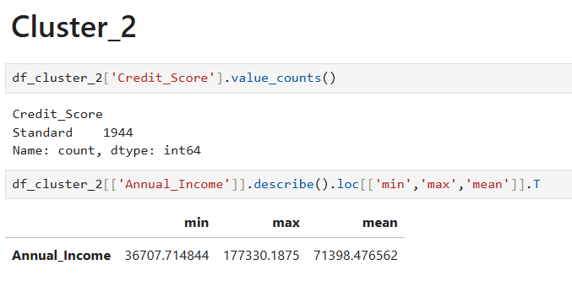
Customer Segmentation-Cluster-2-Insights
Descriptive and Perspective Analysis
Cluster-2
Standard Credit Score: All customers in Cluster 2 have been categorized as having a standard credit score. This indicates that they are likely to have a relatively good credit history and creditworthiness compared to customers with poor or no credit history.
Higher Annual Income: Customers in Cluster 2 have a higher mean annual income of approximately 71,398.48 , with a minimum of 36,707.71 and a maximum of 177,330.19. This suggests that they are in a higher income bracket compared to customers in Cluster 1.
Financial Stability: The combination of a standard credit score and higher annual income indicates that customers in Cluster 2 are likely to be more financially stable. They may have better access to credit and financial resources, making them less sensitive to economic fluctuations.
Lower Risk Profile: From a risk assessment perspective, customers in Cluster 2 may present a lower risk for default or late payments compared to customers in Cluster 1. We may be more inclined to offer them higher credit limits or lower interest rates.
Targeted Financial Products: Customers in Cluster 2 may benefit from a wider range of financial products and services, including higher credit limits, lower interest rates, and premium banking services. Lending institutions may also offer them investment products or wealth management services tailored to their higher income bracket.
Financial Planning: Given their higher income and standard credit score, customers in Cluster 2 may be interested in financial planning services to help them achieve their long-term financial goals. This could include retirement planning, tax planning, and wealth preservation strategies.
Overall, Cluster 2 represents a segment of customers who are more financially stable and have a lower risk profile compared to customers in Cluster 1. They may require different financial products and services that cater to their higher income and creditworthiness.
9

Slide 10
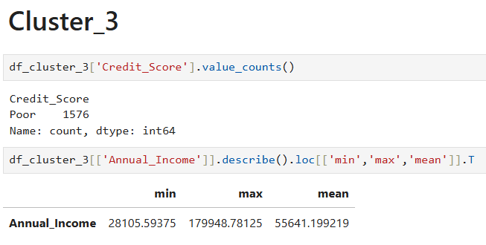
Customer Segmentation-Cluster-3-Insights
Descriptive and Perspective Analysis
Cluster-3
Poor Credit Score: All customers in Cluster 3 have been categorized as having a poor credit score. This suggests that they may have a history of late payments, defaults, or other credit issues that have impacted their creditworthiness.
Moderate Annual Income: Customers in Cluster 3 have a moderate mean annual income of approximately 55,641.20 , with a minimum of 28,105.59 and a maximum of 179,948.78. This indicates that they are in a middle-income bracket.
Financial Challenges: The combination of a poor credit score and moderate income suggests that customers in Cluster 3 may face financial challenges. They may have limited access to credit and financial resources, making it difficult for them to meet their financial obligations.
Higher Risk Profile: From a risk assessment perspective, customers in Cluster 3 may present a higher risk for default or late payments compared to customers in Clusters 1 and 2. We may need to carefully evaluate their creditworthiness and may consider offering them lower credit limits or higher interest rates to mitigate potential risks.
Financial Assistance: Customers in Cluster 3 may benefit from financial assistance programs aimed at improving their creditworthiness and financial stability. This could include credit counseling, debt management plans, or financial education programs.
Targeted Financial Products: Given their financial situation, customers in Cluster 3 may require specialized financial products and services that cater to individuals with poor credit history and moderate income. This could include credit repair services, alternative lending options, or budgeting tools.
Overall, Cluster 3 represents a segment of customers who are facing financial challenges and may require targeted financial products and support to improve their financial stability and creditworthiness.
10

Slide 11
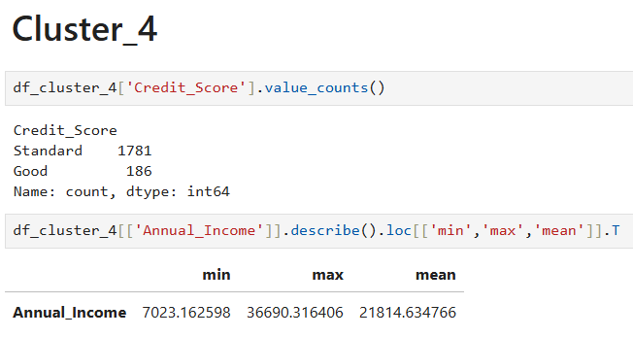
Customer Segmentation-Cluster-4-Insights
Descriptive and Perspective Analysis
Cluster-4
Mixed Credit Scores: Customers in Cluster 4 have a mix of credit scores. The majority have a standard credit score, with 1,781 customers falling into this category. Additionally, there are 186 customers with a good credit score in this cluster.
Moderate Annual Income: Customers in Cluster 4 have a moderate mean annual income of approximately 21,814.63, with a minimum of 7,023.16 and a maximum of 36,690.32. This suggests that they are in a middle to lower-middle income bracket.
Diverse Financial Profiles: The mix of credit scores in Cluster 4 indicates that customers in this cluster have diverse financial profiles. Some may have a strong credit history and creditworthiness (good credit score), while others may have a more average credit profile (standard credit score).
Medium Risk Profile: From a risk assessment perspective, customers in Cluster 4 may present a medium risk for default or late payments. While the majority have a standard credit score, which indicates a relatively good credit history, there are still customers with a good credit score who may present a lower risk.
Financial Stability: The moderate annual income of customers in Cluster 4 suggests that they are relatively stable financially. They may have decent access to credit and financial resources, making them less sensitive to economic fluctuations compared to customers in Cluster 1 and 3.
Targeted Financial Products: Customers in Cluster 4 may benefit from a range of financial products and services tailored to their diverse financial profiles. This could include credit options for those with standard credit scores and investment or savings products for those with good credit scores.
Overall, Cluster 4 represents a segment of customers with diverse financial profiles, moderate risk, and moderate financial stability. They may require a mix of financial products and services to meet their needs and manage their financial well-being
11

Slide 12
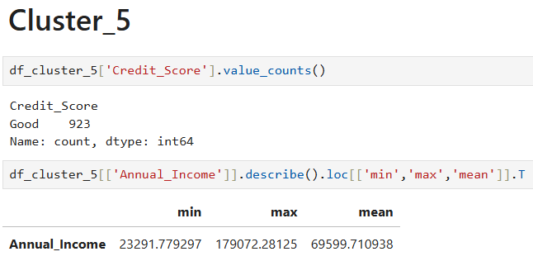
Customer Segmentation-Cluster-5-Insights
Descriptive and Perspective Analysis
Cluster-5
Good Credit Score: All customers in Cluster 5 have been categorized as having a good credit score. This indicates that they have a strong credit history and creditworthiness.
Higher Annual Income: Customers in Cluster 5 have a higher mean annual income of approximately 69,599.71, with a minimum of 23,291.78 and a maximum of 179,072.28. This suggests that they are in a higher income bracket.
Financial Stability: The combination of a good credit score and higher annual income indicates that customers in Cluster 5 are likely to be more financially stable. They may have better access to credit and financial resources, making them less sensitive to economic fluctuations.
Lower Risk Profile: From a risk assessment perspective, customers in Cluster 5 may present a lower risk for default or late payments compared to customers in Clusters 1, 3, and 4. Lending institutions may be more inclined to offer them higher credit limits or lower interest rates.
Targeted Financial Products: Customers in Cluster 5 may benefit from a range of financial products and services tailored to their strong credit profile and higher income. This could include premium banking services, investment products, or wealth management services.
Financial Planning: Given their higher income and good credit score, customers in Cluster 5 may be interested in financial planning services to help them achieve their long-term financial goals. This could include retirement planning, tax planning, and wealth preservation strategies.
Overall, Cluster 5 represents a segment of customers who are financially stable, have a strong credit profile, and are in a higher income bracket. They may require different financial products and services that cater to their higher income and creditworthiness compared to other clusters.
12

Slide 13
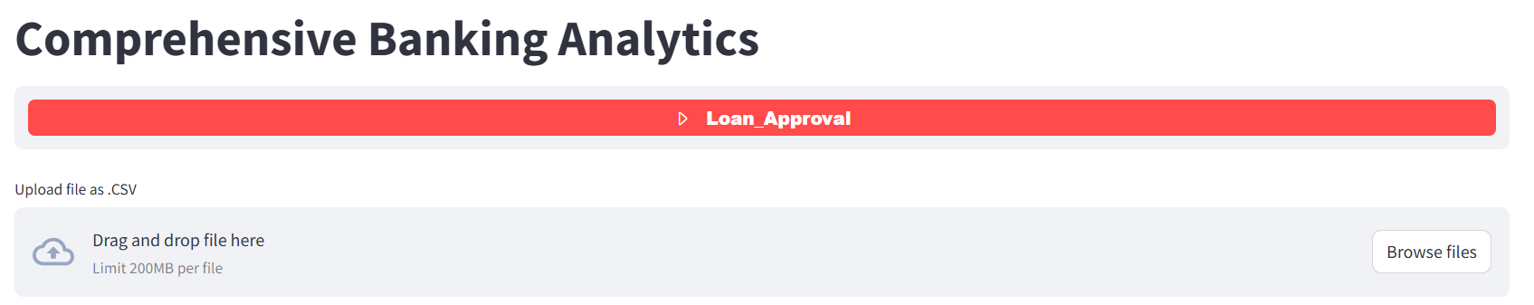
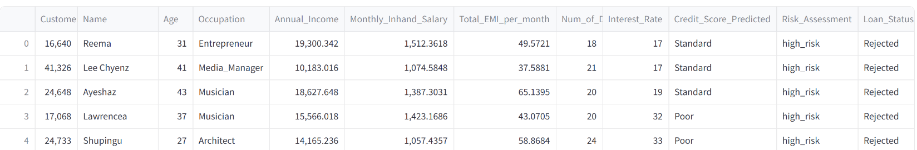

Robust Credit Scoring and Loan Approval System:
Robust Credit Scoring System
By uploading the CSV file to predict credit score and this system enables to approve or reject the loan based on the risk assessment and credit score prediction.
Model Prediction
Approved: We can download the approved loan applicants list by clicking “Download approved loan applicants as CSV file”.
Rejected: We can download the Rejected loan applicants list by clicking “Download Rejected loan applicants as CSV file
13

Slide 14
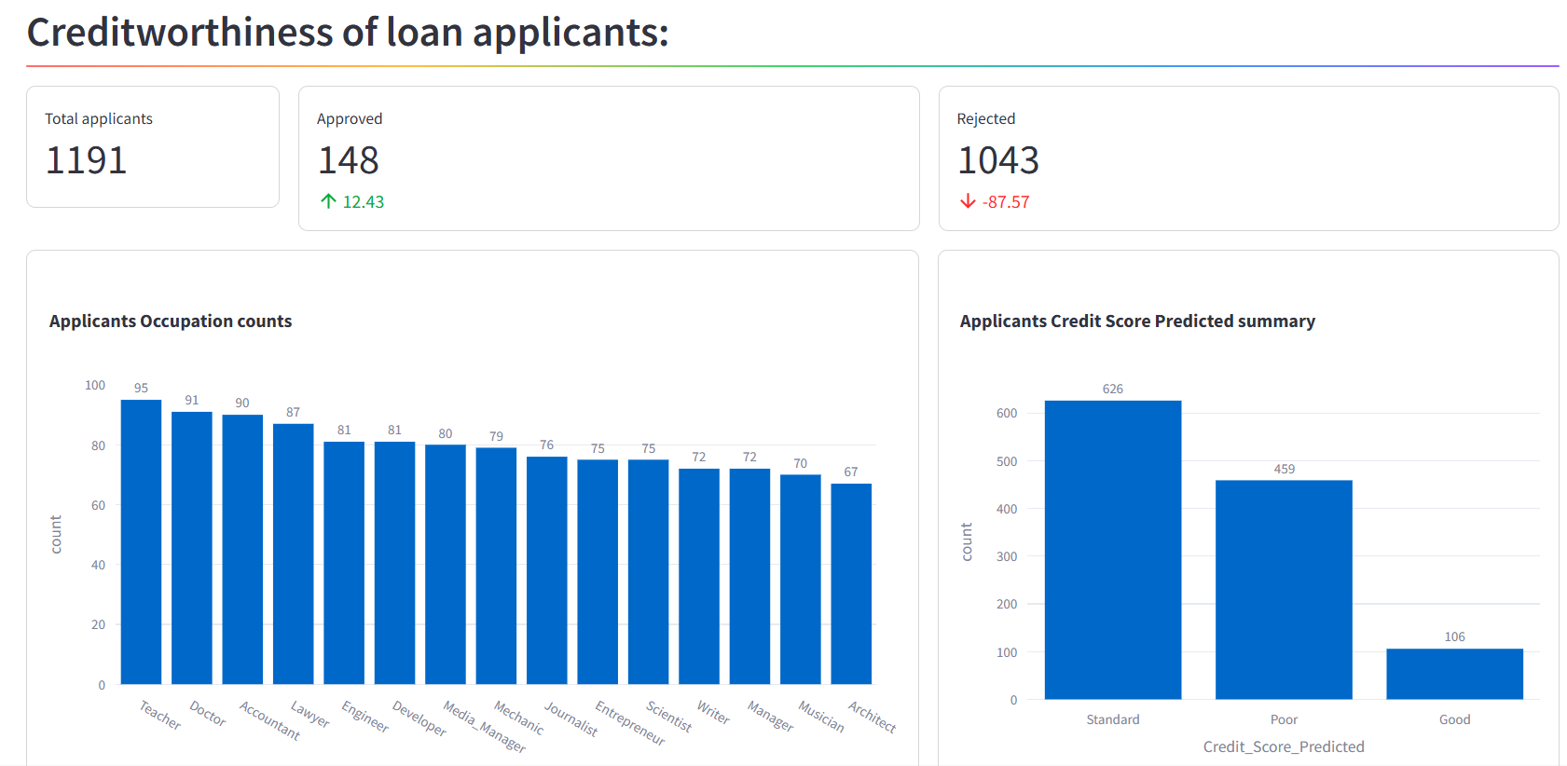
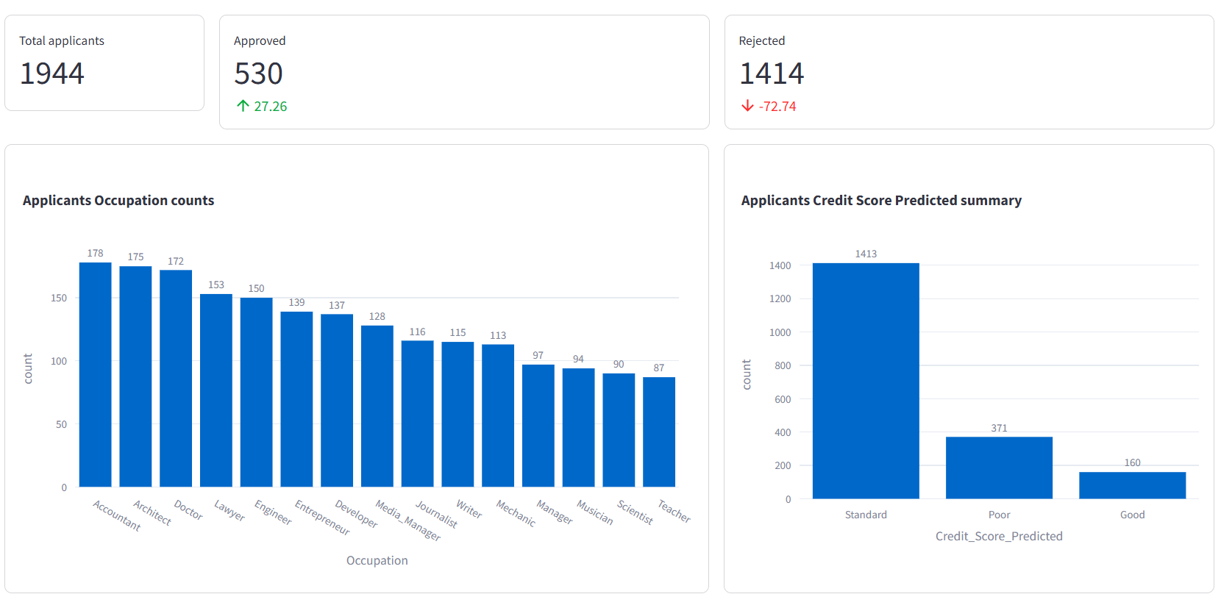
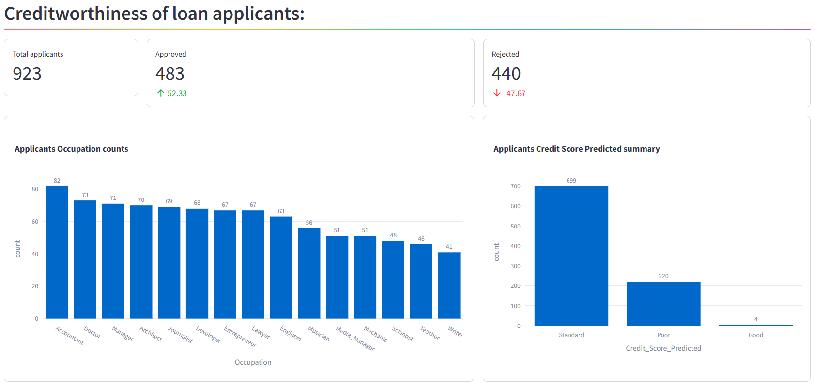
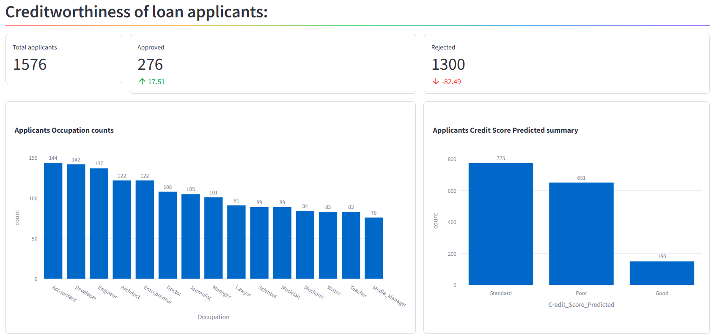
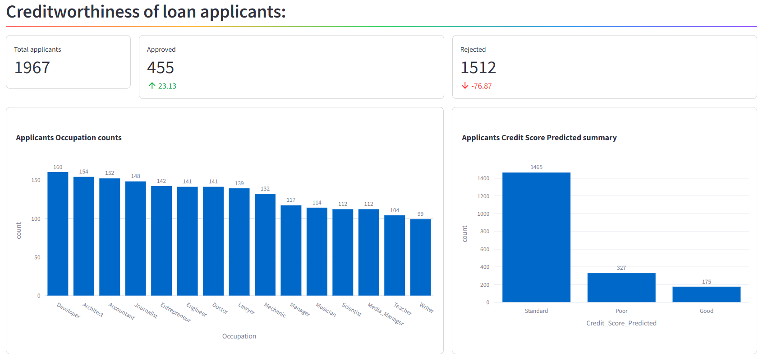
Robust Credit Scoring and Loan Approval System:
Loan Applicants in Cluster-1
Loan Applicants in Cluster-2
Loan Applicants in Cluster-5
Loan Applicants in Cluster-3
Loan Applicants in Cluster-4
Insights
Loan Approval: Displayed the Credit prediction insights from given CSV file. High risk profiles are getting rejected even though they are with Good or Standard credit score. This system provides the high level risk assessment loan approval process.
14

Slide 15

Perspective Analysis
Credit Improvement Programs: Implement programs aimed at helping applicants improve their credit scores. This could include financial education, credit counseling, and credit-building loans.
Diversify Risk Profiles: Consider approving applicants with slightly higher risk profiles but with solid income and financial stability, perhaps with adjusted loan terms or higher interest rates to offset the risk.
15

Slide 16





Thank you
Nandhagopal S
nandha2790@gmail.com
LinkedIn_Profile

